Slide 1
Alzheimer’s Disease Trends in the United States and Tennessee from 1999-2018
Capstone Project for Nashville Software School Data Analytics Cohort 2
John Posey
Data Analyst

Slide 2

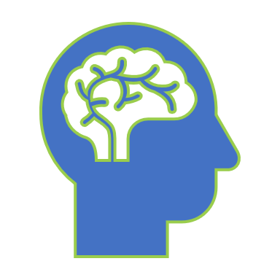
How does your Brain work?

Slide 3
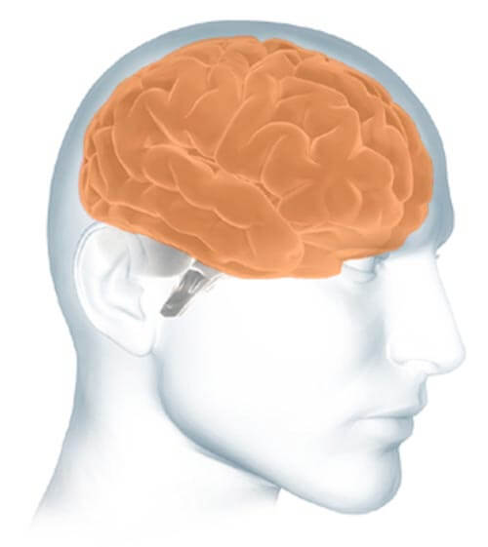
Parts of the Brain
The cerebrum fills up most of your skull. It is involved in remembering, problem solving, thinking, and feeling. It also controls movement.
https://www.alz.org/alzheimers-dementia/what-is-alzheimers/brain_tour

Slide 4
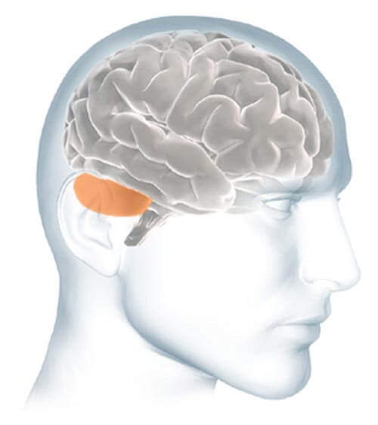
Parts of the Brain
The cerebellum sits at the back of your head, under the cerebrum. It controls coordination and balance.
https://www.alz.org/alzheimers-dementia/what-is-alzheimers/brain_tour

Slide 5
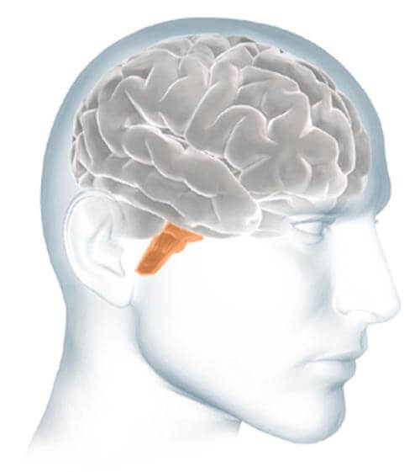
Parts of the Brain
The brain stem sits beneath your cerebrum in front of your cerebellum. It connects the brain to the spinal cord and controls automatic functions such as breathing, digestion, heart rate and blood pressure.
https://www.alz.org/alzheimers-dementia/what-is-alzheimers/brain_tour

Slide 6
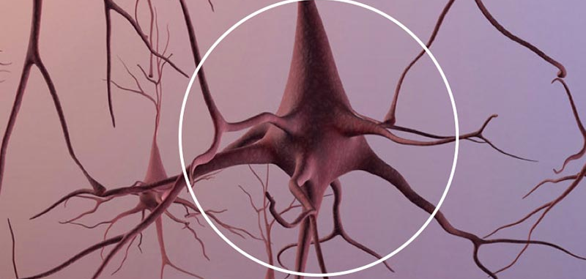
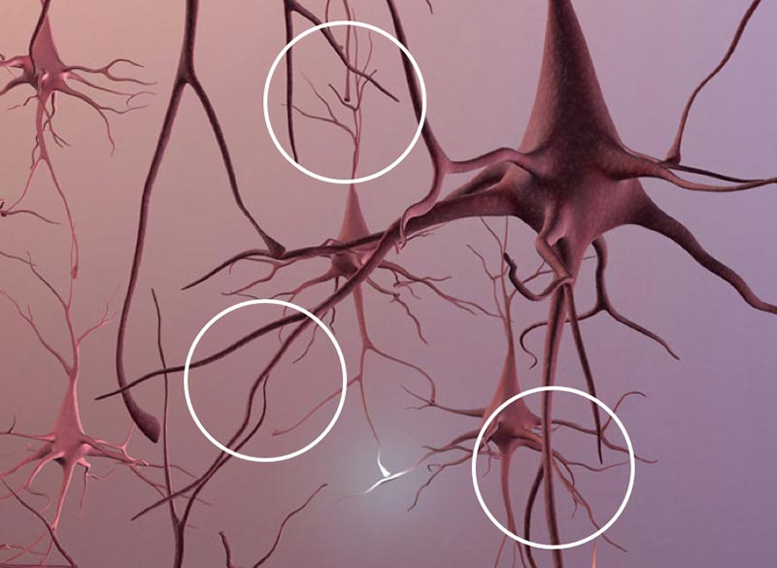
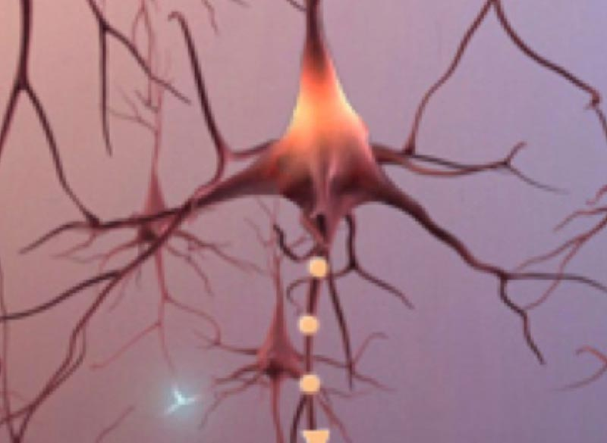
Neurons
Total Neurons
Branches
Signals
An adult brain contains about 100 billion nerve cells.
Branches connect the nerve cells at more than 100 trillion points. Scientists call this dense, branching network a "neuron forest."
Signals traveling through the neuron forest form the basis of memories, thoughts, and feelings.

Slide 7

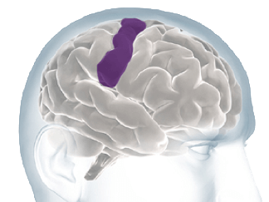
Interpret Sensations From Your Body

Slide 8
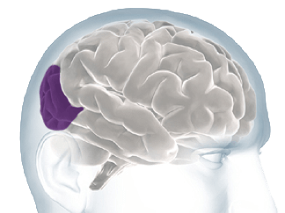
Processing Sights

Slide 9
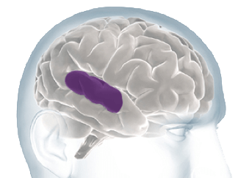
Processing Sounds

Slide 10
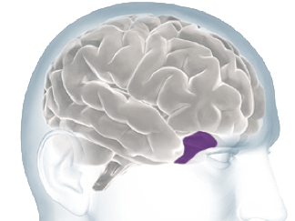
Processing Smells

Slide 11
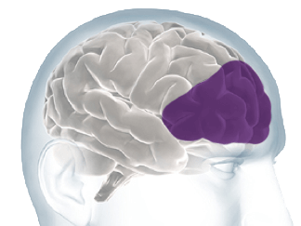
Thoughts, Problem Solving And Planning

Slide 12
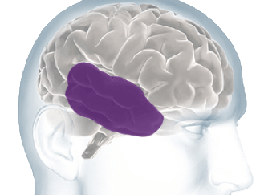
Forming & Storing Memories

Slide 13
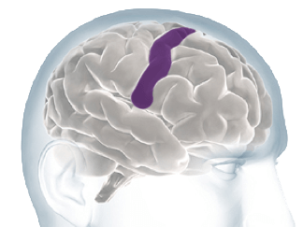
Controlling Voluntary Movement

Slide 14
Alzheimer’s Disease pathology and presentation
What Alzheimer’s Disease is?
how it affects those diagnosed?

Slide 15
What is Alzheimer’s Disease?
According to the Alzheimer’s Association, Alzheimer’s is a subset of a mental disorder known as Dementia. It affects memory, thinking and overall behavior. Symptoms can eventually grow severe enough that they interfere with daily everyday tasks.

Slide 16
Understanding Alzheimer’s
Alzheimer’s is the most common form or cause of Dementia. Dementia is a general term for loss of memory or other cognitive abilities.
Alzheimer’s accounts for 60-80% of Dementia cases.
Alzheimer’s is not a normal part of aging. There are numerous cases of early-onset Alzheimer’s (which is anyone under 65 years of age)
Alzheimer’s currently has no cure. Treatment for symptoms is the best available course of action.
A few quick facts about Alzheimer’s disease:
Notes:
Note on #2: the other most common causes being Vascular Dementia and Parkinson’s Disease.

Slide 17
Alzheimer’s Disease, Brain Function, and Cognitive Decline
Ad’s effect on brain function and the resulting cognitive decline.

Slide 18
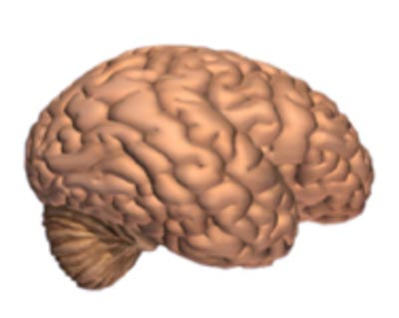
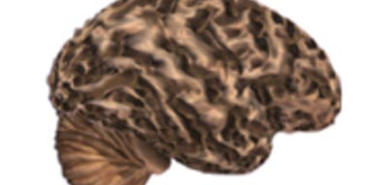
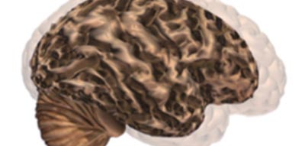
Alzheimer’s leads to nerve cell death and loss of brain tissue. The brain shrinks dramatically, greatly affecting functions.
Brain without Alzheimer’s Disease.
Brain with advanced Alzheimer’s
Comparison image of the two
No noticeable brain tissue degradation
Noticeable tissue degradation
See the difference between the two models.

Slide 19
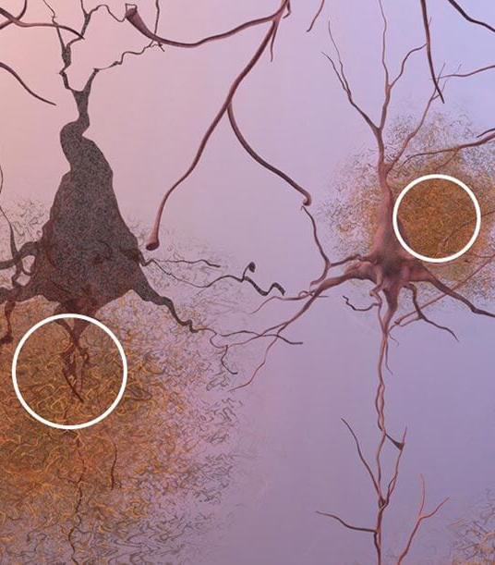
Formation of Plaques
Plaques, which are abnormal clusters of fragments of protein, gather and build up between and around the nerve cells. This picture is of brain tissue under a microscope. Scientists and Doctors are not sure what causes cell death and loss of tissue, but plaques and tangles are the current theories.

Slide 20
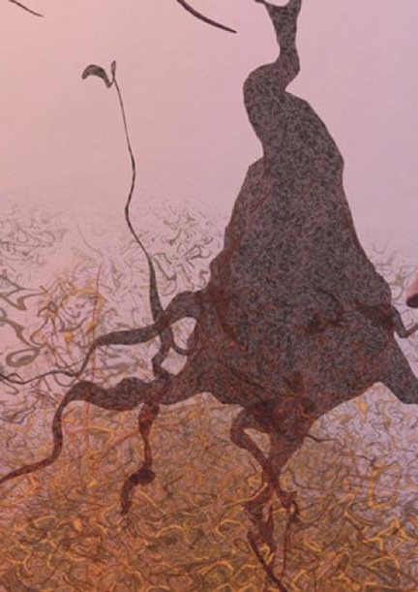
Tangles
Dead and dying nerve cells containing tangles which are twisted strands of a different protein.

Slide 21
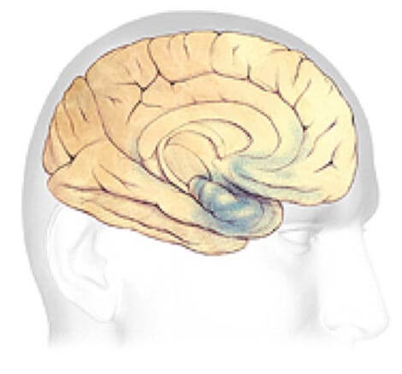
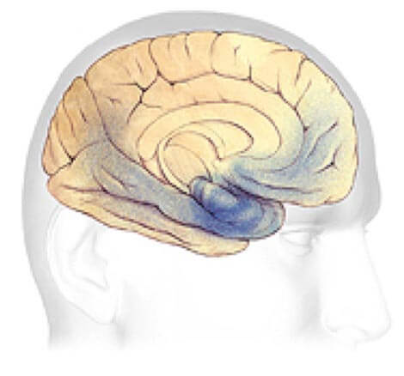
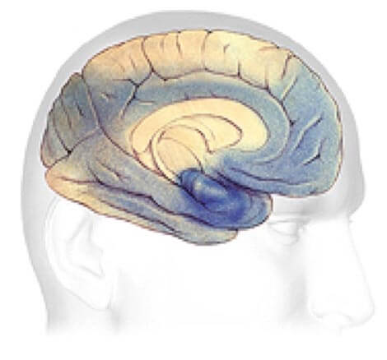
Plaque and Tangle Progression Plaque and Tangles (shown in blue) spread through the cortex. Rate of progression varies wildly from case to case.
Early Alzheimer’s
Mild to Moderate Stages
Severe, late stage
Changes to brain can begin 20 years or more before diagnosis.
Generally, lasts between 2-10 years
May last from 1-5 years.

Slide 22
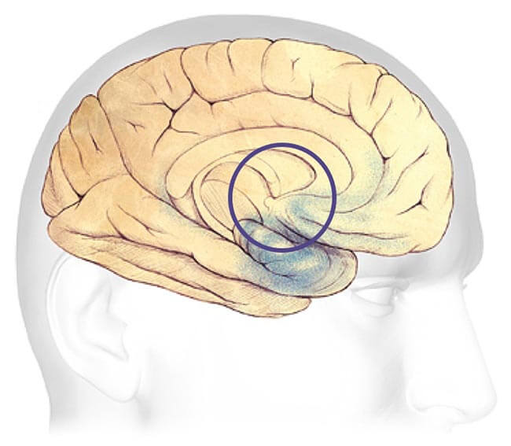
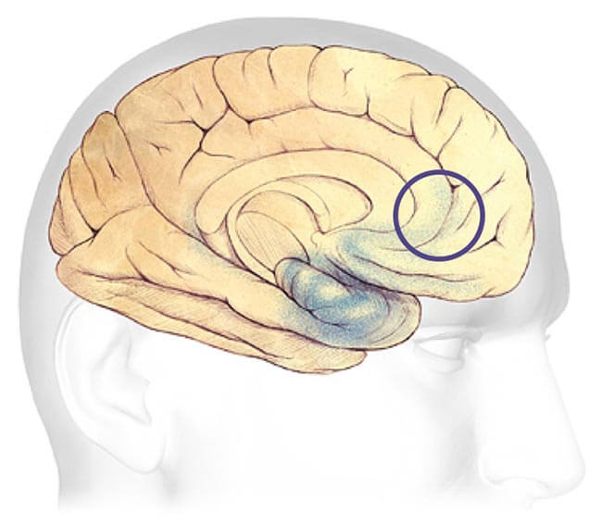
Earliest Alzheimer’s Stages
Before symptoms can be detected with tests, the plaques and tangles begin forming in the areas of the brain most involved with:
Learning and Memory
Thinking and Planning

Slide 23
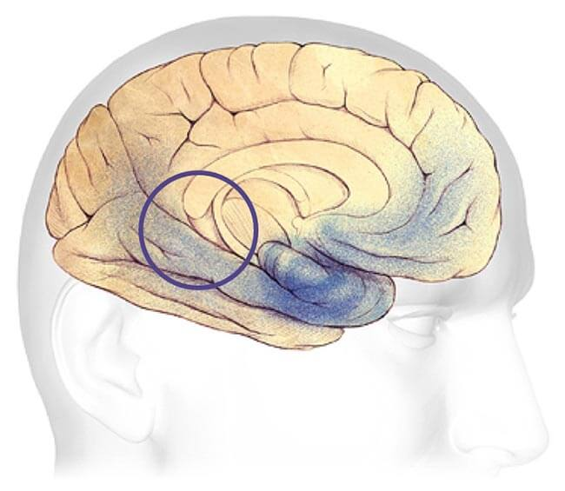
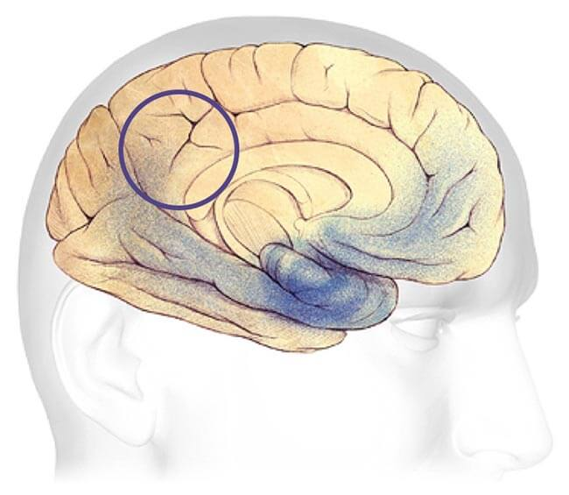
Mild - Moderate Alzheimer’s Stages
Most common stage of diagnosis. Develop problems with memory or thinking that affects daily life. Might also start getting confused and have issue handling money, expressing themselves, or even organizing thoughts.
Speaking and Understanding Speech
Sense of bodily position to objects

Slide 24
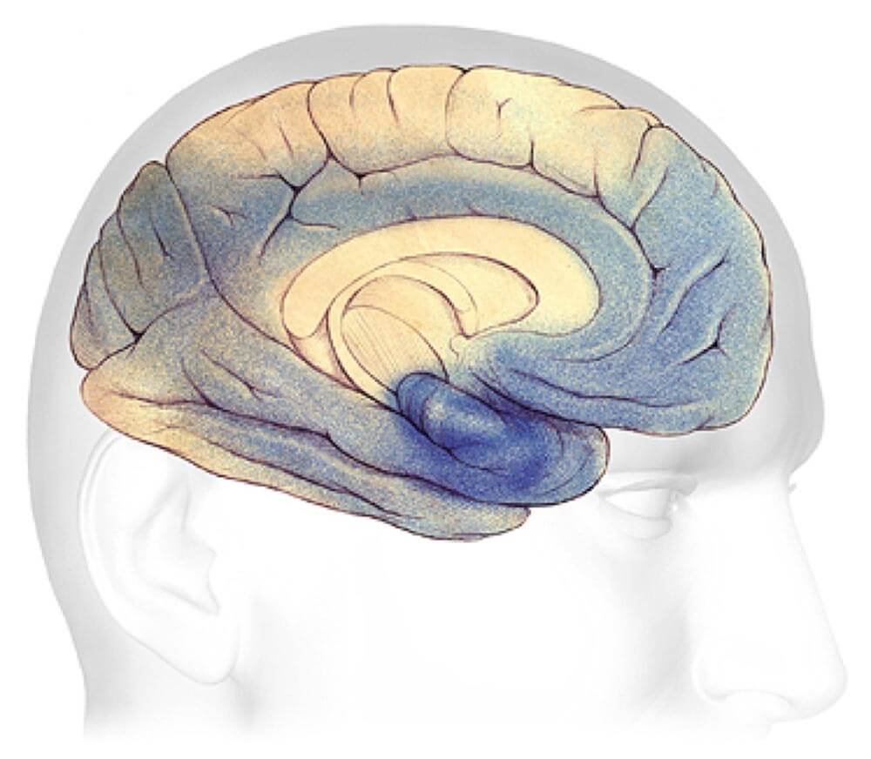
severe Alzheimer’s Stage
Most of the cortex has been severely damaged. Brain will shrink dramatically due to widespread brain cell death.
Loss of ability to communicate
Failure to recognize family or loved ones or care for self

Slide 25
Overall Trend in the United States 1999-2018
Overall trend in AD–related deaths in the United States between 1999-2018.

Slide 26
Power Bi Presentation
Alzheimer's Disease Presentation

Slide 27
Overall Trend in Tennessee 1999-2018
Overall trend in AD–related deaths in Tennessee between 1999-2018.

Slide 28
Power Bi Presentation
Alzheimer's Disease Presentation

Slide 29
What to do if You or someone you love has Alzheimer’s Disease?
A short guide for Family and friends

Slide 30
First Steps
Don’t Panic.
There is support and a community there for you and/or your loved one.
Talk to your Doctor.

Slide 31
next Steps
Contact your local Alzheimer’s Association.
They can help with getting you in touch with AD and Dementia specialists in your area.
Start making legal and financial plans.

Slide 32
Further Steps
Live Well.
Reduce Stress
Embrace your community
Become an Advocate or Leader
Participate in Clinical Trials
Help to overcome the stigma

Slide 33



Resources
Links to various organizations and programs for help.
Tennessee Chapter

Slide 34
More Resources
24/7 Helpline
1-800-272-3900
Education Programs
Alzheimer’s Association Programs
https://www.alz.org/help-support/i-have-alz/programs-support

